Slide 1
Lightning System
Ashley Parilla, Ethan Schwab, Ben Luss, Caitlin Rock, Owen Adams
Notes:
Caitlin
Backstory:

Slide 2
Idea Overview
Our product is a system of AI Cameras that will be able to determine if players are offsides.
Notes:
Caitlin

Slide 3
Why
Causes conflict between coaches, players, and refs.
Creates more objective decision making.
Overall satisfaction/experience for coaches, players, refs, and fans
Notes:
Caitlin

Slide 4
Why: Statistics
Offside: 14 – 5 upheld, 9 overturned (64%)
Goals lost via challenge: 3, 2, 1
Goals earned via challenge: 1
Low usage of challenge
Notes:
Owen

Slide 5
Why: Statistics
Linesman terrible at calling offside
Thin margin to make the call with view of naked eye
More reviews from coaches called
Reviews take too long, sucking out the excitement
Notes:
owen

Slide 6
Offside Calls per Game
Notes:
Owen

Slide 7
Value Proposition
The offsides ruling in hockey has caused many issues, the Lightning System will prove to be an effective tool to bring some technological legitimacy into a referee's job, alleviating tension. Utilization of artificial intelligence cameras can detect offsides in a moments notice at game speed. In turn, this fast-paced sport will become further streamlined, and save the players, coaches, and fans the agony of a bad call.
Notes:
Ben

Slide 8
Key Terms

Slide 9
Artificial Intelligence
intelligence demonstrated by machines, able to solve simple tasks.
Notes:
Ethan

Slide 10
Machine Learning
An application of AI that provides systems the ability to automatically learn and improve from experience without being explicitly programmed

Slide 11
Vison Sensor
uses position, orientation, contrast, and lightning to determine and track motion.

Slide 12
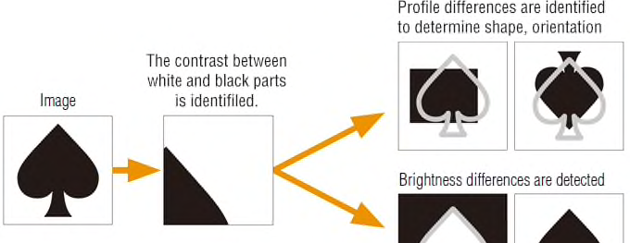
Vision Sensor Explained

Slide 13
Functionality
Our system will use a series of 6 cameras that are placed above the ice 3 on each side of the glass. Which all have the Sony IMX501 vision sensors built into them. These cameras watch the game and track movement across the ice the entire game. They are on rotating arms so they can move almost like a security camera can move.

Slide 14

The issue with image sensors now is that they process everything in the frame which takes lots of time. So our chip is smart and only processes the necessary data needed to complete the computer program. This in turn makes everything faster, more secure, and cheaper.

Slide 15

This chip allows the camera to detect specific moving objects and then track their individual movement. So our product can track the objects movement, determine the most probable path the object will take, and the precise dimensions of the object. Similar to the way the crosswalks show up in this video the blue lines will show up in our systems.

Slide 16

Prior to the start of the game, an arena employee must input starting sides and the precise dimensions of the arena into the AI system. Which is controlled by a central computer in the control room.

Slide 17

Our system has been trained through hundreds of thousands of computer simulations to best understand what depicts offsides. This gives our system an accurate baseline to judge from.

Slide 18
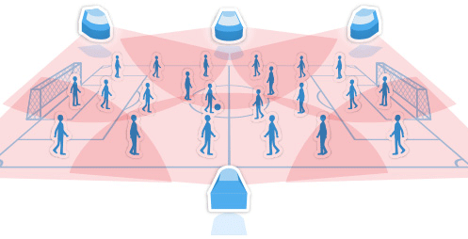

Slide 19

Each camera uses the motion of the puck and players gathered from the vision sensors showing the exact location of the players and the puck at any given time.

Slide 20
Captures pictures every millisecond of the locations of these entities on the ice. Pictures from each camera are compared against each other to determine the most accurate call. The picture that you see now is how the cameras will be oriented around the arena.

Slide 21
The AI computer program inside the heart of our system scans each frame that is captured to determine if a player is in the offensive zone before the puck. They use the movement of the players and puck as well as quantitative data to determine this. This analysis process takes less than a second to complete.

Slide 22

Outcomes

Slide 23

If offsides is detected the arena horn is sounded and play stops.

Slide 24

Data is gathered and stored to better prove the accuracy of our product which will in turn generate more sales.

Slide 25

Our system uses Machine Learning to become smarter overtime and can recognize offsides simply from seeing the same type of frame multiple times. This will help improve our product over time to become smarter and even faster. The depths of AI are rather unknown, but it may be possible to totally get rid of referees soon, which would be incredibly cost efficient.

Slide 26
What: The Virtual Fabric
Narrow Artificial Intelligence System
  Virtual Fabric Ice Rink that tracks the location of the sensors in the skates and puck
  Tracks movement over the blue lines by both
  If offsides is sensed horn goes off a
Notes:
Ethan

Slide 27
Target Market
Junior Hockey League: USHL
Western Conference
Commissioner (Tom Garrity)
Director of Operations (Evan Rand)
Notes:
Ashley
The target market for The Lightning System is the Western Conference of the United States Hockey League, which is a part of the Junior Hockey League. The Western Conference consists of 8 different teams. We would need Tom Garrity, who is the commissioner of the USHL, to approve the use of the lightning system.

Slide 28
Market Segmentation
Demographic: 16-21 yr.
280 players
Garrity and Rand: White males in 40s, Substantial income
USHL: Non-Price Sensitive
Geographic: Western United States
Notes:
Ashley
Players in the USHL range from 16-21 years old. There are about 280 players in this conference which is about 35 players per team. The majority of USHL teams are located in the Midwest.

Slide 29
Who: Market Segmentation
Behavioral: Overall better game play
Psychographic: Hockey 24/7
Anything that helps game play
Notes:
Ashley
The behavior of our target market is that the players and the USHL will buy anything to better the game of hockey and buy anything that will help them compete to be the best. Hockey players for the USHL play 62 regular season games every year meaning that hockey is their life and everything they do is shaped by the game.
We choose the USHL because they don’t have professional referees, Coaches challenge is not allowed in overturning incorrect calls in the USHL, whereas it is a very prevalent method for the NHL, Video cameras in USHL rinks are low quality causing for issues with reviewing plays, there are Only 8 rinks that would require the system, and its Easily expandable to the Eastern Conference of the USHL and higher levels of hockey once more data is collected.

Slide 30
How: Revenue Model
Get infront of the Commisoner and Director and pitch why they need our product
Domino effect to other leagues
Notes:
Ben
contract is a cost-type contract (also known as an open-book contract) where the contractor is compensated for actual costs incurred plus a fixed fee subject to a ceiling price.

Slide 31
Competition
Referees and Linesman
No competition
Notes:
Ben

Slide 32
Works Cited
articles, Jonny Finity 33, et al. “The 5 Main Types of Construction Contracts Explained.” Levelset, Publisher Name LevelsetPublisher Logo, 14 May 2020, www.levelset.com/blog/construction-contracts-5-main-types/.
“Home.” USHL, www.ushl.com/.
McIndoe, Sean. “The Offside Rule Is Ruining the NHL Playoffs – and the Mess Could Get Worse.” The Guardian, Guardian News and Media, 25 Apr. 2016, www.theguardian.com/sport/blog/2016/apr/25/nhl-playoffs-offside-rule-ice-hockey.
“NHL Coach’s Challenge Tracker 2019-20- Players.” Scouting The Refs, 22 Sept. 2020, scoutingtherefs.com/2020/09/29785/nhl-coaches-challenge-tracker-20190-20-playoffs/.
NHL.com. “Official Site of the National Hockey League.” NHL.com, www.nhl.com/.

